Slide 1
COT5615: Math for Intelligent Systems I
Anand Rangarajan
Lecture 25

Slide 2
Convolutional Neural Networks
Paradigmatic case: 2D grayscale images
2D Convolution (usually correlation) with kernel (filter)
No FFT-based implementation (though recent papers tout FFT speedup*)
Three main ideas: Convolution, parameter sharing, equivariant reps.
CNN:
First stage: Convolution
Second stage: Non-linear activation function (ReLU, sigmoid etc.)
Third stage: Pooling (max, average) for the sake of approx. invariance (equivariance)
*Fast training of convolutional networks through FFTs, M. Mathieu et al., arXiv:1312.5851v5, 2014

Slide 3
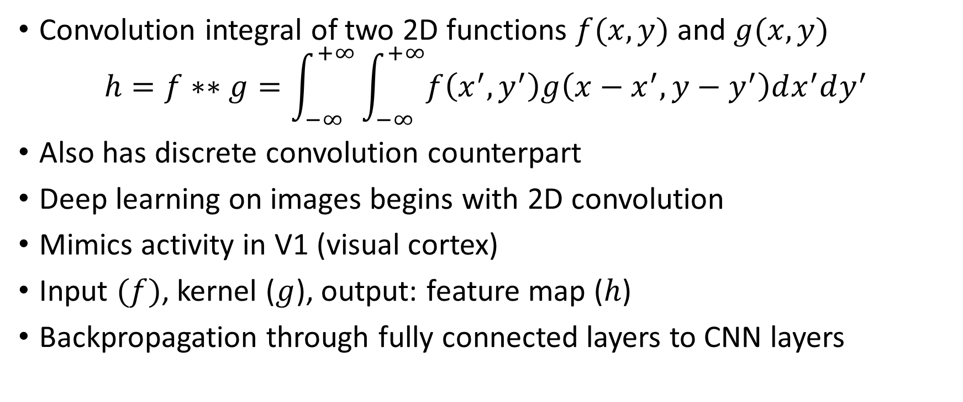
Two-dimensional convolution
Convolution integral of two 2D functions $f(x,y)$ and $g(x,y)$
$$h=f∗∗g=\int_{−∞}^{+∞}{\int_{−∞}^{+∞}{f\left(x^{′},y^{′}\right)g\left(x−x^{′},y−y^{′}\right)dx^{′}dy^{′}}}$$
Also has discrete convolution counterpart
Deep learning on images begins with 2D convolution
Mimics activity in V1 (visual cortex)
Input $(f)$, kernel ($g$), output: feature map ($h$)
Backpropagation through fully connected layers to CNN layers

Slide 4
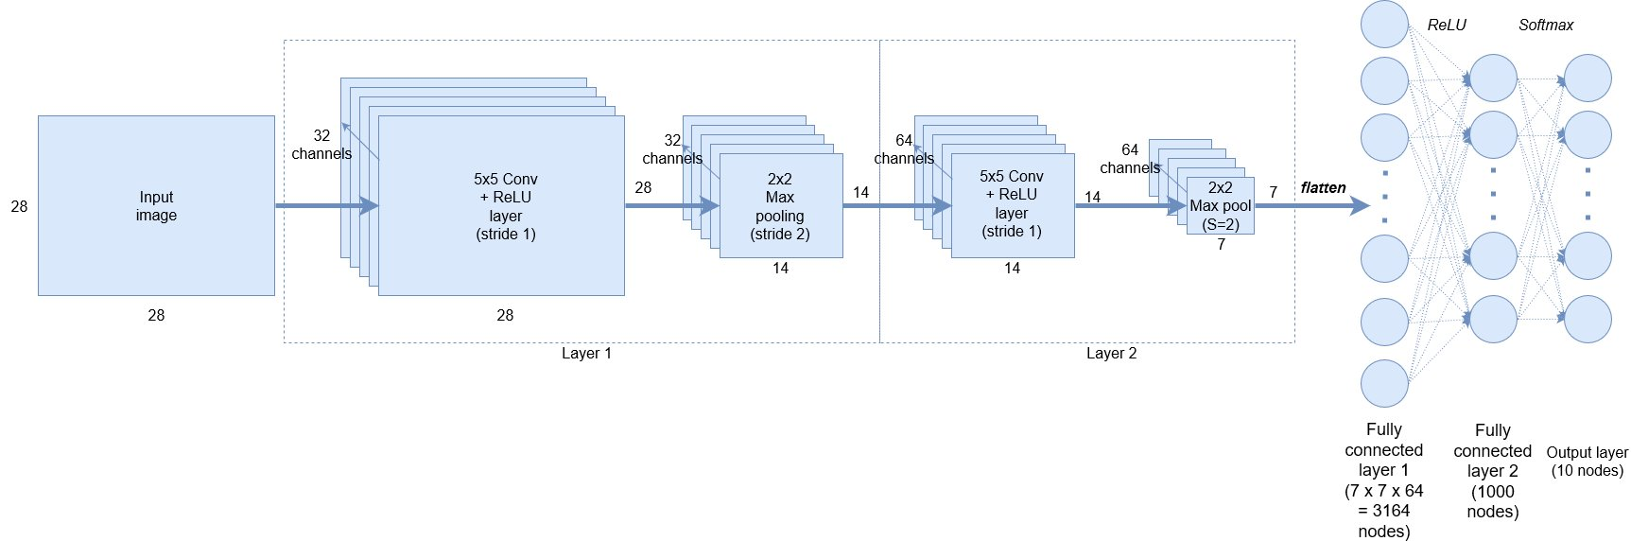
CNN Block Diagram

Slide 5
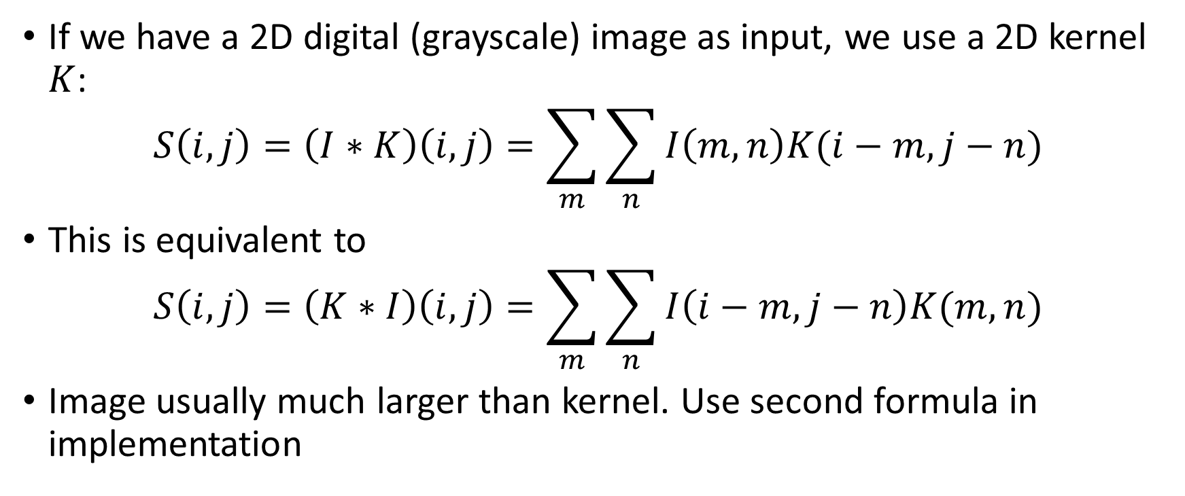
Discrete 2D Convolution
If we have a 2D digital (grayscale) image as input, we use a 2D kernel $K$:
$$S\left(i,j\right)=\left(I∗K\right)\left(i,j\right)=\sum_{m}{\sum_{n}{I\left(m,n\right)K(i−m,j−n)}}$$
This is equivalent to
$$S\left(i,j\right)=\left(K∗I\right)\left(i,j\right)=\sum_{m}{\sum_{n}{I\left(i−m,j−n\right)K(m,n)}}$$
Image usually much larger than kernel. Use second formula in implementation

Slide 6
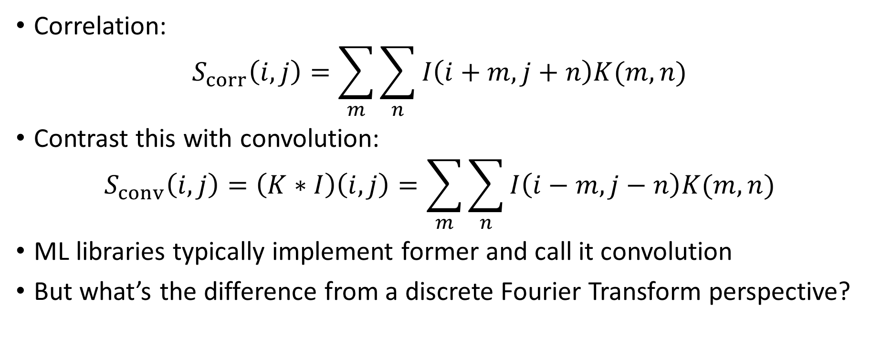
Convolution vs. Correlation
Correlation:
$$S_{corr}\left(i,j\right)=\sum_{m}{\sum_{n}{I\left(i+m,j+n\right)K(m,n)}}$$
Contrast this with convolution:
$$S_{conv}\left(i,j\right)=\left(K∗I\right)\left(i,j\right)=\sum_{m}{\sum_{n}{I\left(i−m,j−n\right)K(m,n)}}$$
ML libraries typically implement former and call it convolution
But what’s the difference from a discrete Fourier Transform perspective?

Slide 7
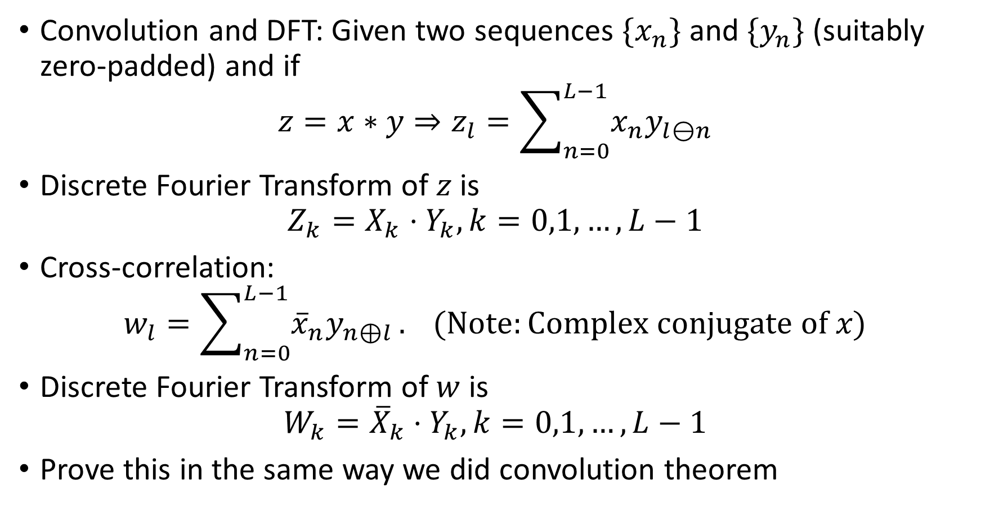
Circular Convolution vs. Correlation in 1D
Convolution and DFT: Given two sequences $\{x_{n}\}$ and $\{y_{n}\}$ (suitably zero-padded) and if
$$z=x∗y⇒z_{l}=\sum_{n=0}^{L−1}{x_{n}y_{l⊖n}}$$
Discrete Fourier Transform of $z$ is
$$Z_{k}=X_{k}⋅Y_{k}, k=0,1,…,L−1$$
Cross-correlation:
$$w_{l}=\sum_{n=0}^{L−1}{{\overline{x}}_{n}y_{n⊕l}}. (Note:Complex conjugate of x)$$
Discrete Fourier Transform of $w$ is
$$W_{k}={\overline{X}}_{k}⋅Y_{k}, k=0,1,…,L−1$$
Prove this in the same way we did convolution theorem

Slide 8
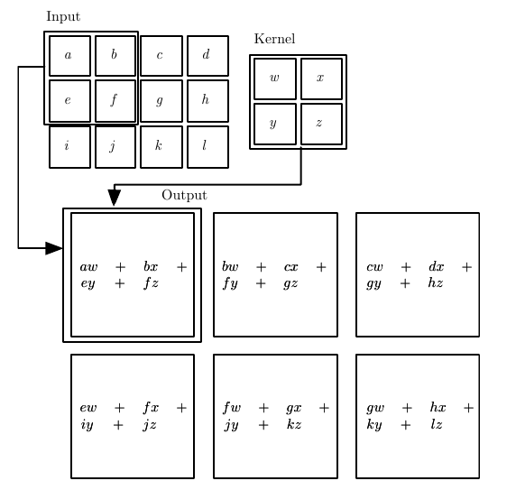
2D Convolution
No kernel flipping
Kernel does not go outside image boundary
Cannot be trivially implemented by FFT

Slide 9
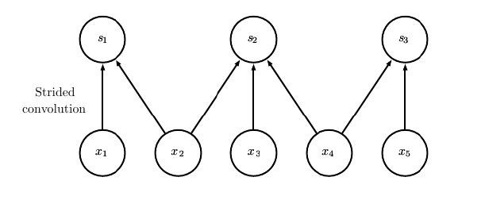
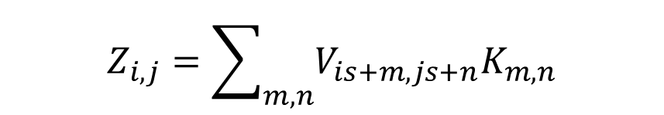
Convolution with a Stride
$$Z_{i,j}=\sum_{m,n}{V_{is+m,js+n}K_{m,n}}$$

Slide 10
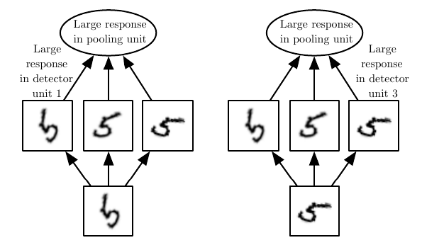
Pooling
Learned invariances: Max pooling has large activation regardless of orientation

Slide 11
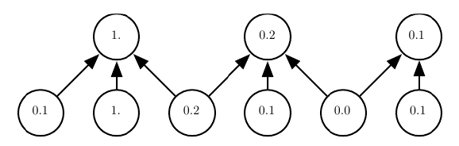
Pooling with Strides
Pooling with downsampling: Max-pooling with pool width of 3 and a stride between pools of 2. Next layer reduced by factor of 2.

Slide 12
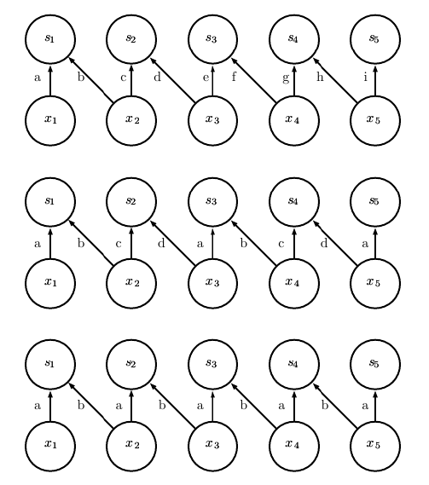
Locally connected layer
Tiled convolution
Standard convolution

Slide 13
Summary
Convolution with a kernel in multiple dimensions
Pooling: reduces size of next layer, approx. invariance
Strides: convolution with strides allows kernel to skip over image (downsampling)
Can use zero padding to reduce shrinkage in every layer
Can also use local network weights: Unshared convolution
Convolution (shared across locations, unshared) alt. to fully connected
Other variants

